Slide 1

Introduction to Electric and Electronics Fall, 2023
School of
Computer Science and Engineering
Pusan National University
Jeong Goo Kim

Slide 2
강의계획
Class Day/Time: Tue., Thu./ 13:30-14:45
Classroom: Engineering Bldg. #6, Room 6203
Instructor: Jeong Goo Kim
Office: Research & Lab. Bldg. #1, Room 420
Phone: 510-3733
E-mail: kimjg@pusan.ac.kr
URL: http://abc.cse.pusan.ac.kr
Office Hours: Tue., Thu./15:00 -16:00
Homework: Due one week from day assigned (unless otherwise specified)
Grading: Attendance: 10 % Homework: 25% Final Exam: 30% Mid Term Exam: 30% Presentation: 5%

Slide 3
Outline
TEXT
Essentials of Electrical and Computer Engineering, J. David Irwin, and David V. Kerns, Jr., Wiely, 2022.
Useful References (Books):
Fundamentals of Electric Circuits, 2nd ed., Charles K. Alexander & Matthew N.O. Sadiku, McGraw-Hill, 2003.
Electric Circuits, J.W. Nilsson & S.A. Riedel, Prentice-Hall, 2005.
Useful Articles: Attached at the end of every printed matter
Purpose of the Course
Basic electricity and electronics are introduced in this class
1. Study basic knowledge of electricity such as voltage and current
2. Study DC circuits and AC circuits
3. Study basic knowledge of the semiconductor.
4. Understand Diode and Transistor circuits and their application
All the information on this class will be posted at https://plato.pusan.ac.kr/

Slide 4
Class Schedule
Class Schedule
Week | Contents | Note
1 | Fundamentals of Electric and Electronic
2 | The Basic Laws of Circuit Analysis I
3 | The Basic Laws of Circuit Analysis II
4 | Circuit Analysis Techniques I
5 | Circuit Analysis Techniques II | HW1
6 | Transient Analysis
7 | AC Steady-State Analysis | HW2
8 | Midterm Exam.
9 | Variable-frequency Network Characteristics | HW 3
10 | Diode, Semiconductors and Applications
11 | Operational Amplifiers
12 | OP Amp Applications | HW4
13 | Analog Electronics: MOSFET
14 | Analog Electronics: BJT | HW5
15 | Final Exam.
Note: Schedule may be changed according to the progress of classwork with notification

Slide 5
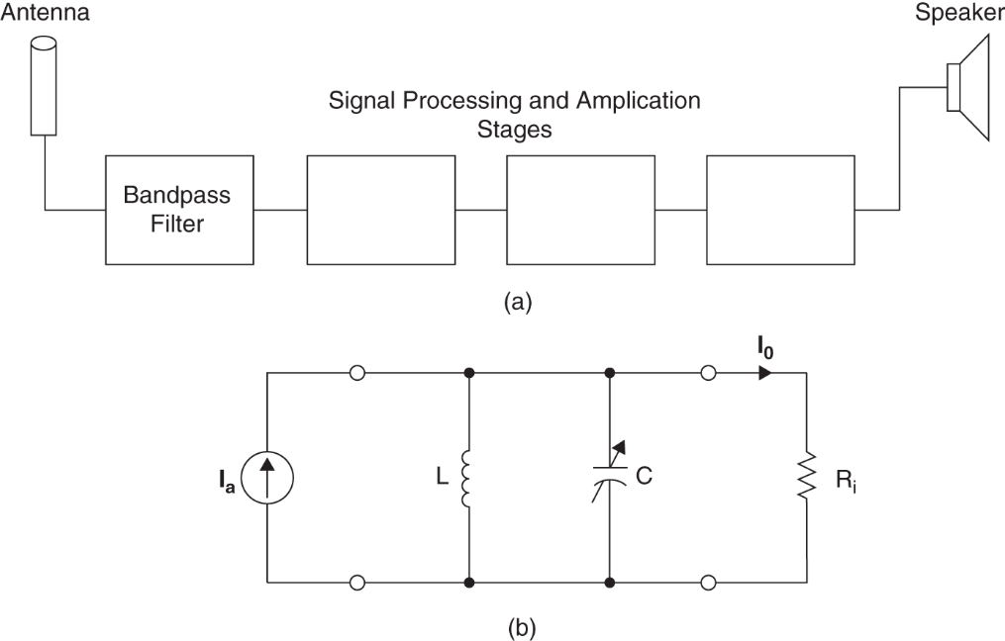
Electric Circuits
Electric Circuits
Simplified block diagram for an AM radio
A simple circuit used to model the radio’s performance

Slide 6
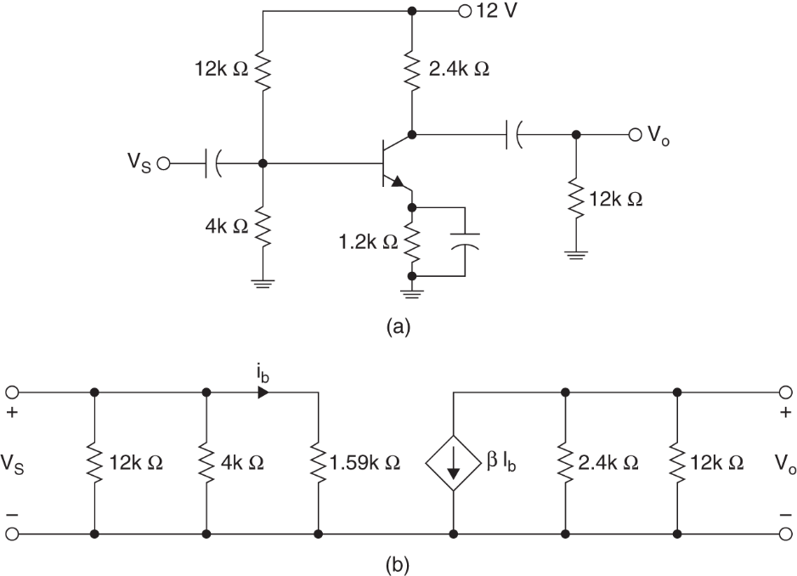
Electronics
Electronics
NPN common emitter amplifier circuit
Small-signal equivalent circuit

Slide 7
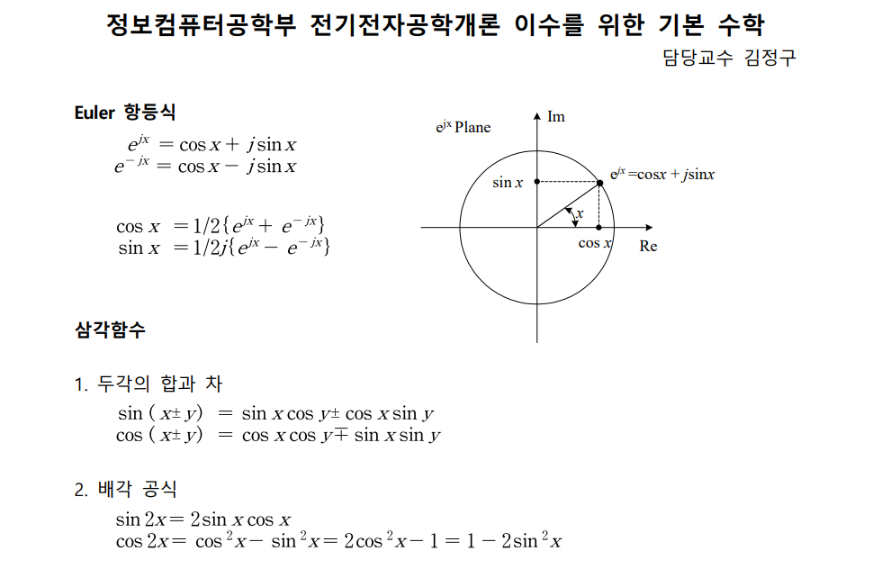
Math

Slide 8
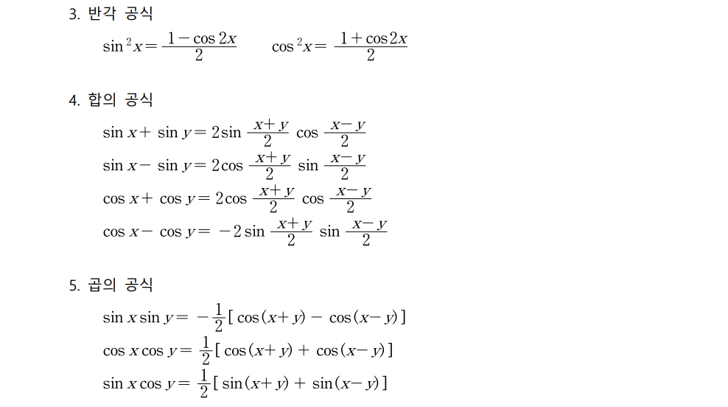
Math

Slide 9
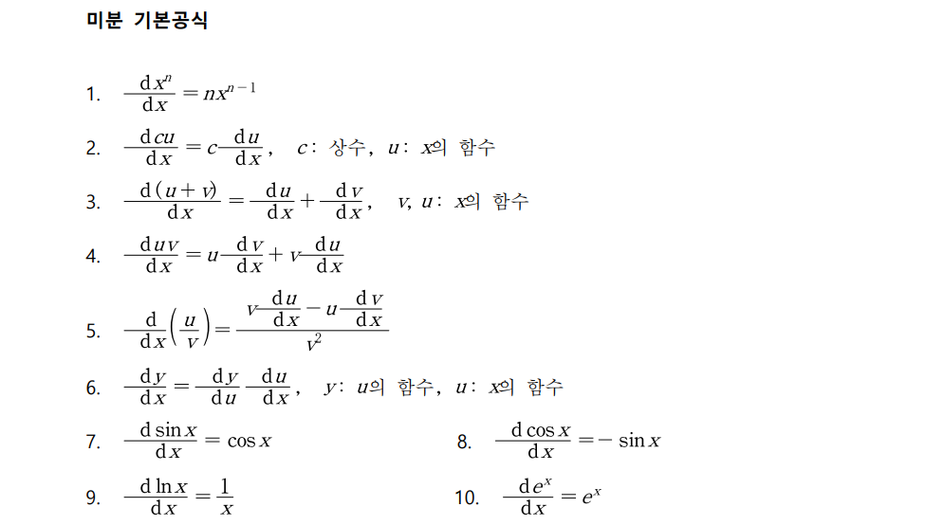
Math

Slide 10
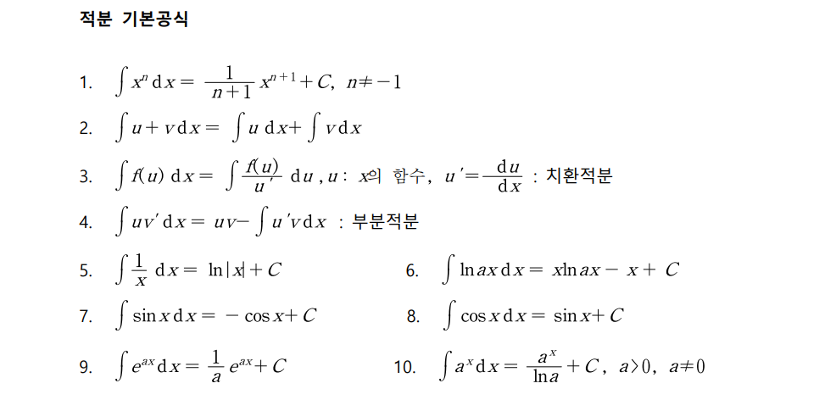
Math

Slide 11
Homework
Homework
Read Text Chapter 1. pp. 1-9
Prepare Presentation

